Slide 1
A+ Computer Science
JAVA ARRAYS

Slide 2
What is a List?

Slide 3
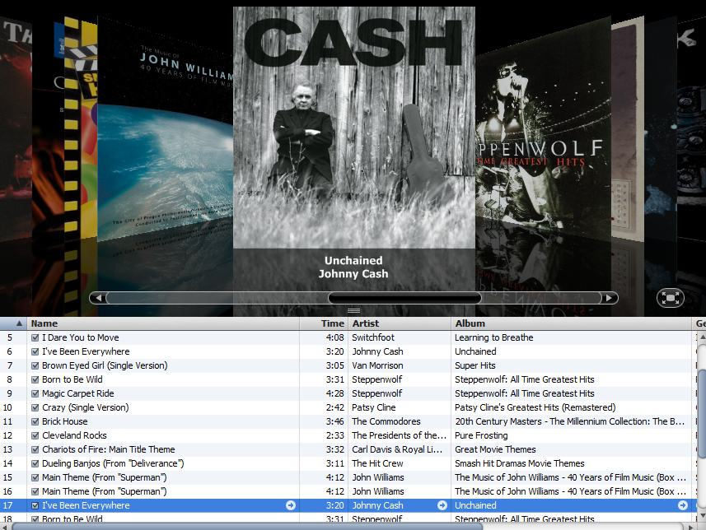


Slide 4
What is an array?

Slide 5
What is an array?
An array is a group of items all of the same type which are accessed through a single identifier.
int[] aplus = new int[10];
0 1 2 3 4 5 6 7 8 9
nums
0 | 0 | 0 | 0 | 0 | 0 | 0 | 0 | 0 | 0
Notes:
An array is a collection of boxes / spots / items that all store the same type of value. Each spot in the array stores a value of the same type.
Each spot in the array is essentially a single variable of the type specified.
int[] array = new int[10]; array can store 10 integers. array is basically a collection of 10 integer variables. Spot 0 stores the 1st integer, spot 1 stores the 2nd integer, and so on.

Slide 6
What is a reference?
int[] aplus;
aplus
null
null
nothing
aplus is a reference to an integer array.
Notes:
A reference variable is used to store the location of an Object. In most situations, a reference stores the actual memory address of an Object.
nums stores the location / memory address of an integer array.

Slide 7
Array Instantiation
new int[3];
0x213
0 | 0 | 0
arrays are Objects.
Notes:
A reference variable is used to store the location of an Object. In most situations, a reference stores the actual memory address of an Object.
In the example above, an array Object has been instantiated. There is nothing referring to the Object.

Slide 8
What is an array?
int[] aplus = new int[3];
aplus
0x213
0x213
0 | 0 | 0
aplus is a reference to an integer array.
Notes:
A reference variable is used to store the location of an Object.
In most situations, a reference stores the actual memory address of an Object.
aplus stores the location / memory address of an integer array.

Slide 9
What is an array?
String s = "compsci"; //Strings are arrays
0 1 2 3 4 5 6
s
c | o | m | p | s | c | i
The first index position in a String is 0.
A String is an array of characters.
Notes:
A String is a character array. String s is storing "compsci". Spot [0] is storing character c and spot [length-1] is storing character i. Each spot in the String s is storing a single character.

Slide 10
What is an array?
int[] aplus = new int[10]; //Java int array
0 1 2 3 4 5 6 7 8 9
nums
0 | 0 | 0 | 0 | 0 | 0 | 0 | 0 | 0 | 0
Arrays are filled with 0 values when instantiated.
The exact value of each spot in the array depends
on the specified type for the array.
Notes:
When arrays are instantiated, each spot / box is filled with a zero value.
Integers have a zero value of 0, doubles have a zero value of 0.0, and characters have a zero value of 0 which happens to be a space.
A reference array would be filled with null. Arrays of references will be discussed later.

Slide 11
What is an array?
new int[10]; //Java int array
0 1 2 3 4 5 6 7 8 9
0 | 0 | 0 | 0 | 0 | 0 | 0 | 0 | 0 | 0
Once an array object has been instantiated,
the size many never change. To increase or
decrease the size, a new array would need to
be instantiated and all old value copied.
Notes:
The size of an array object can never change. Arrays do not have methods that allow for the removal or addition of items. In order to add or remove items, a new array would be instantiated and all old values copied to the new array.

Slide 12
What is an array?
int[] aplus = {2,7,8,234,745,1245};
0 1 2 3 4 5
aplus
2 | 7 | 8 | 234 | 745 | 1245
An array can be initialized with values.
Notes:
Instantiating an array with a list of values is a great way to save some time if the values the array will store are known.
In the example above, aplus is initialized with the value list 2,7,8,234,745,1245.
Spot [0] is storing 2 and spot [length-1] is storing 1245.

Slide 13
What is an array?
0 1 2 3 4 5 6 7 8 9
aplus
9 | 0 | 0 | 0 | 0 | 0 | 0 | 0 | 0 | 0
The [spot/index] indicates which value in the array is being manipulated.
aplus[0] = 9;
The 0 spot is being set to 9.
Notes:
Individual spots in an array are accessed by using a number.
The number indicates which spot you are accessing.
Only integer values can be used to [access] a spot in an array.
[int only]
out.println(aplus[3]); //outs 0
out.println(aplus[0]); //outs 9

Slide 14
What is an array?
Java indexes must always be integers
and the first index will always be 0.
0 1 2 3 4 5 6 7 8 9
aplus
0 | 0 | 0 | 0 | 0 | 0 | 0 | 0 | 0 | 0
Notes:
Individual spots in an array are accessed by using a number.
The number indicates which spot you are accessing.
Only integer values can be used to [access] a spot in an array.
[int only]

Slide 15
arrayinit.java

Slide 16
Printing Array Values

Slide 17
Printing Array Values
int[] nums = {2,3,5,1,0,6,7};
out.println(nums[0]); out.println(nums[2]);
out.println(nums[5]);
OUTPUT2 5 6
0 1 2 3 4 5 6
nums
2 | 3 | 5 | 1 | 0 | 6 | 7
Notes:
Once the array has been instantiated and has values, it is very simple to print/access a particular spot. An integer value must be provided to indicate which [spot] will be accessed.
int[] thoseNums = {5,7,3,6,9};
out.println(thoseNums[3]); //outs 6
out.println(thoseNums[1/2]); //outs 5
// 1/2 is 0
out.println(thoseNums[2+2]); //outs 9
out.println(thoseNums[5/2]); //outs 3
// 5/2 is 2

Slide 18
Printing Array Values
int[] nums = {2,3,5,1,0,6,7};
out.println( nums[ 1 + 3 ] ); out.println( nums[ 7 / 2 ] );
out.println( nums[ 6 ] );
DOES MATH INSIDE, THEN CHECKS ARRAY (1+3=4->0)
OUTPUT0 1 7
0 1 2 3 4 5 6
nums
2 | 3 | 5 | 1 | 0 | 6 | 7
Notes:
Once the array has been instantiated and has values, it is very simple to print/access a particular spot. An integer value must be provided to indicate which [spot] will be accessed.
int[] thoseNums = {5,7,3,6,9};
out.println(thoseNums[3]); //outs 6
out.println(thoseNums[1/2]); //outs 5
// 1/2 is 0
out.println(thoseNums[2+2]); //outs 9
out.println(thoseNums[5/2]); //outs 3
// 5/2 is 2

Slide 19
arrayprintone.java arrayprinttwo.java

Slide 20
Setting Array Spots

Slide 21
Setting Array Values
int[] nums = new int[10];
nums[0] = 231;
nums[4] = 756;
nums[2] = 123;
out.println(nums[0]);
out.println(nums[1]);
out.println(nums[4]);
out.println(nums[4/2]);
OUTPUT
231 0 756 123
Notes:
An integer value must be provided when accessing a [spot] in an array.
nums[0]=231; is setting spot 0 to the value 231.

Slide 22
Setting Array Values
double[] nums = new double[10];
nums[0] = 10.5;
nums[3] = 98.6;
nums[2] = 77.5;
out.println(nums[0]);
out.println(nums[3]);
out.println(nums[7]);
OUTPUT
10.5 98.6 0.0
Notes:
nums has been instantiated with the capacity to store 10 doubles. All spots are set to 0.0 to start.
An integer value must be provided when accessing a [spot] in an array.
nums is storing double values, but the index/spot value must be an integer.
nums[0]=10.5; //sets spot 0 to the value 10.5.

Slide 23
Setting Array Values
String[] words = new String[10];
words[0] = "dog";
words[3] = "cat";
words[2] = "pig";
out.println( words[0] );
out.println( words[3] );
out.println( words[7] );
OUTPUT
dog cat null
Notes:
words has been instantiated with the capacity to store 10 String references.
All spots are set to null to start.
An integer value must be provided when accessing a [spot] in an array.
words is storing String references, but the index/spot value must be an integer.

Slide 24
arraysetone.java arraysettwo.java

Slide 25
Accessing Arrays with Loops

Slide 26
Accessing Array Values
int[] nums = {3,2,5,1,0,6};
for(int spot=0; spot<nums.length; spot++)
{
out.println(nums[spot]);
}
OUTPUT3 2 5 1 0 6
length returns the # of
elements/items/spots in the array!!!
Notes:
Using loops to print all spots in an array is a necessary approach.
As array lengths could change with different input values, it is
good to use a for loop based on length. If length changes, the loop will change accordingly.
The loop variable will start at 0 and go up to the array length.
The loop variable will be used to access each [spot] in the array.

Slide 27
Accessing Array Values
int[] nums = {3,2,5,1,0,6};
for(int item : nums)
{
out.println(item);
}
OUTPUT3 2 5 1 0 6
0 1 2 3 4 5
nums
3 | 2 | 5 | 1 | 0 | 6
Notes:
The for each loop is a great tool to use when accessing array values if a spot/index variable is not needed.
The for each loop above accesses all values in nums and prints each one.
Each time the loop iterates, the next value from nums is pasted into item.
The for each loop will iterate as long as the structure it is connected to has values.
int[] nums = {1,2,3,4,5,6,7};
for(int item : nums)
{
out.print(item + " ");
}
//outs 1 2 3 4 5 6 7

Slide 28
Accessing Array Values
int[] nums = new int[6];
for(int spot=0; spot<nums.length; spot++)
{
nums[spot] = spot*4;
}
0 1 2 3 4 5
nums
0 | 4 | 8 | 12 | 16 | 20
Notes:
Using loops to print all spots in an array is a necessary approach.
As array lengths could change with different input values, it is
good to use a for loop based on length. If length changes, the loop will change accordingly.
The loop variable will start at 0 and go up to the array length.
The loop variable will be used to access each [spot] in the array.

Slide 29
Accessing Array Values
String[] wrds = {"cat","pig","dog"};
for(String item : wrds)
{
out.println(item);
}
OUTPUTcat pig dog
0 1 2
wrds
cat | pig | dog

Slide 30
arrayloopone.java arraylooptwo.java

Slide 31
Counting Array Values

Slide 32
Counting Array Values
In order to count the number of occurrences of a particular value, you must use a loop to access all items in the array.
You must also include an if statement to check for the specified value and a variable with which to count each of the variable’s occurrences.
Notes:
Counting the number of occurrences of a particular item requires using a loop and a variable. The loop must iterate over all items in the list and the if statement must check each item. The variable will be used to count how many of a particular type exist.

Slide 33
Counting Array Values
loop through all array items
if current item == search value
increase the count by 1
Notes:
Counting the number of occurrences of a particular item requires using a loop and a variable. The loop must iterate over all items in the list and the if statement must check each item. The variable will be used to count how many of a particular type exist.

Slide 34
Counting Array Values
//assume nums is an array with values
int count = 0; for( int item : nums )
{
if ( item matches provided value )
count = count + 1;
}
//return or print count
Notes:
The for each loop is a great tool to use when accessing array values if a spot/index variable is not needed.
The for each loop above accesses all values in nums.
Each time the loop iterates, the next value from nums is pasted into item.
The for each loop will iterate as long as the structure it is connected to has values.
int[] nums = {1,2,3,4,5,6,7};
for(int item : nums)
{
out.print(item + " ");
}
//outs 1 2 3 4 5 6 7

Slide 35
arraycount.java

Slide 36
Deleting Array Values

Slide 37
Deleting Array Values
Once instantiated, the size of an array can never change.
int[] nums = {1,7,8,7,4,3,7};
Notes:
Once an array Object has been created, the size of that array can never change.
The values in the array can change, but not the size.
In order to remove values from an array, a new array must be created with an appropriate size considering how many items are to be removed. Old values must then be copied to the new array.

Slide 38
Deleting Array Values
To delete values, a new array must be instantiated.
int[] newRay = new int[ size ];
Notes:
Once an array Object has been created, the size of that array can never change.
The values in the array can change, but not the size.
In order to remove values from an array, a new array must be created with an appropriate size considering how many items are to be removed. Old values must then be copied to the new array.

Slide 39
Deleting Array Values
Values must be copied from the old array to the new one.
int[] nums = {1,7,8,7,4,3,7}; int[] newRay = new int[ size ];
loop through nums copy stuff to newRay
Notes:
Once an array Object has been created, the size of that array can never change.
The values in the array can change, but not the size.
In order to remove values from an array, a new array must be created with an appropriate size considering how many items are to be removed. Old values must then be copied to the new array.

Slide 40
Deleting Array Values
int[] nums = {1,7,8,7,4,3,7};
To delete all 7s
Count the 7s
Create an array set to count of non 7s
Copy all non 7s to new array
Notes:
Once an array Object has been created, the size of that array can never change.
The values in the array can change, but not the size.
In order to remove values from an array, a new array must be created with an appropriate size considering how many items are to be removed. Old values must then be copied to the new array.

Slide 41
arraydelete.java

Slide 42
Arrays as Instance Variables

Slide 43
Array Instance Variables
public class Array
{
private int[] nums; //has the value null
public Array(){
nums = new int[10]; //sizes the array
}
//other methods not shown
}
Notes:
int[] should only appear in front of nums once.
int[] should only appear on the left of nums when defining nums as an instance variable.
int[] should never appear on the left of nums in a constructor or any method.
The array must be instantiated and sized in the constructor.

Slide 44
arrayivars.java

Slide 45
toString( )
public class Array
{
//instance vars and other methods not shown
public String toString()
{
String output= "";
for(int spot=0; spot<nums.length; spot++)
{
output=output+nums[spot]+" ";
}
return output;
}
}
Notes:
To toString() method will use a loop to access all spots in the array. The value in each spot will be added to output and returned at the end of the toString() method.

Slide 46
toString( )
public class Array
{
//instance vars and other methods not shown
public String toString()
{
String output= "";
for( int val : nums )
{
output = output + val + " ";
}
return output;
}
}
Notes:
To toString() method will use a loop to access all spots in the array. The value in each spot will be added to output and returned at the end of the toString() method.

Slide 47
arrayivarstwo.java

Slide 48
The Arrays Class

Slide 49
sort
int nums[] = {45,78,90,66,11};
Arrays.sort(nums);
for(int item : nums)
out.println(item);
OUTPUT 11
45
66
78
90
0 1 2 3 4
ray
11 | 45 | 66 | 78 | 90
Notes:
The built in Java Arrays.sort() method will naturally order all values in the array.
The values in the array will be in ascending order after the call to sort().
Arrays.sort() uses a quick sort to sort primitives and a merge sort to sort references.

Slide 50
toString( )
int[] n = {45,78,90,66,11};
System.out.println( Arrays.toString(n));
0 1 2 3 4
OUTPUT
[45, 78, 90, 66, 11]
n
11 | 45 | 66 | 78 | 90
Notes:
toString will print out the array just like the toString for ArrayList.

Slide 51
arrays_class.java

Slide 52
Work on Programs!
Crank
Some Code!

Slide 53
A+ Computer Science
JAVA ARRAYS

